Slide 1
“Shannon game for predicting next word”
Venali Sonone

Slide 2
About me
UIBS
MBA Grad (Present)
Philip Morris
Data Scientist
(March’18 – Present)
MIT Media Labs
Junior Research Scientist
(April’14 – May’15)
Rakuten
Machine Learning Engineer
(June’16 – Feb’18)
Barclays
Data Analyst
(May’15 – July’15)

Slide 3
SCIKIT-LEARN
Scikit-Learn is beautiful! It’s just wonderful…..
Everything is a well designed workflow
Transform
Fit
Predict

Slide 4
KERAS
KERAS is very similar to scikit ! It’s just wonderful too…..
Keras API is like lego.
AND
Everything done in scikit can be transferred to keras.

Slide 5
What is Shannon game?
Shannon (1950) estimated the entropy of written English to be between 0.6 and 1.3 bits per character (bpc), based on the ability of human subjects to guess successive characters in text.

Slide 6
So we predict next word!
Why? for fun ;p

Slide 7
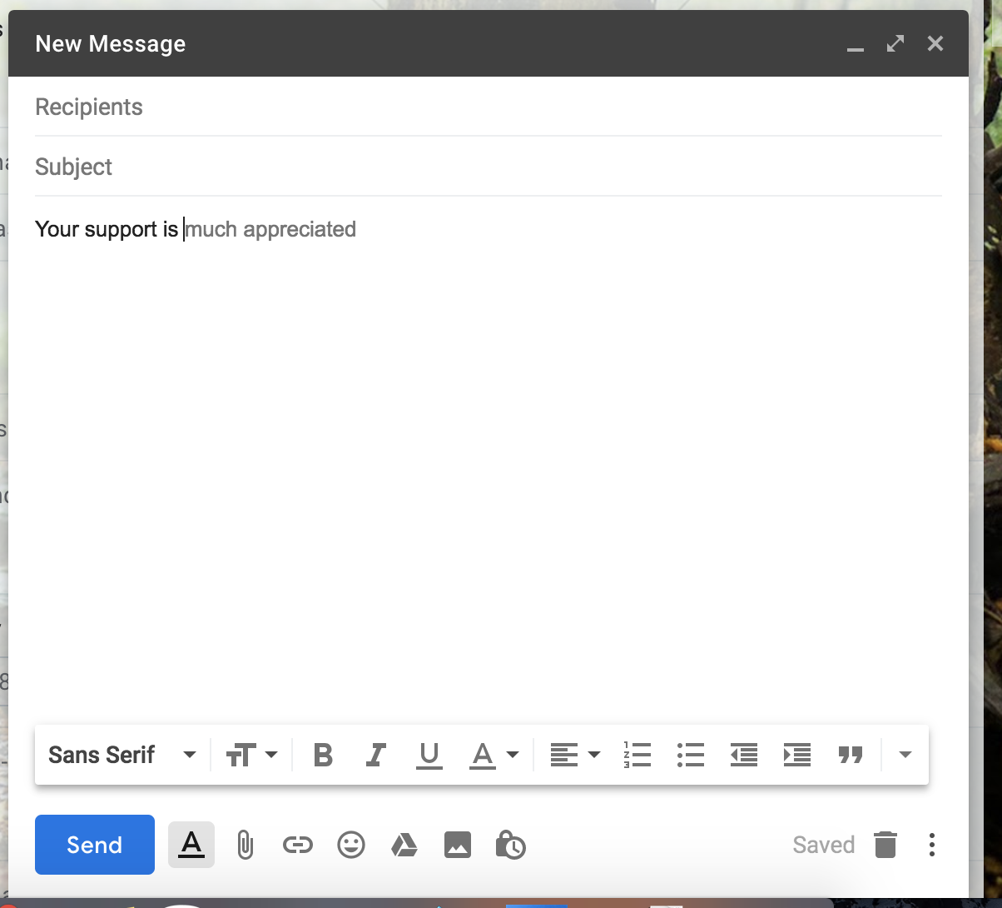
Consider recent update in gmail auto word suggestion.

Slide 8
What is sequence-to-sequence learning?
Sequence-to-sequence learning (Seq2Seq) is about training models to convert sequences from one domain to sequences in another domain.
(e.g. sentences in English) => (e.g. the same sentences translated to French) "the cat sat on the mat" -> [Seq2Seq model] -> "le chat etait assis sur le tapis"
(e.g. sentences in English) => (e.g. sentences in English with some differentiation) "the cat sat on the" -> [Seq2Seq model] -> "cat sat on the mat"

Slide 9
Important stuff
Keras: has 1. Computational graphs 2. Sequential Loss: 1. Softmax 2. Sigmoid Optimizer: e.g. adam Regularization: l1,l2,l1l2 Epoch: mini batches for showing how much data to adjust weights Padding: fixed length sequence. 8341000000 8347120949

Slide 10
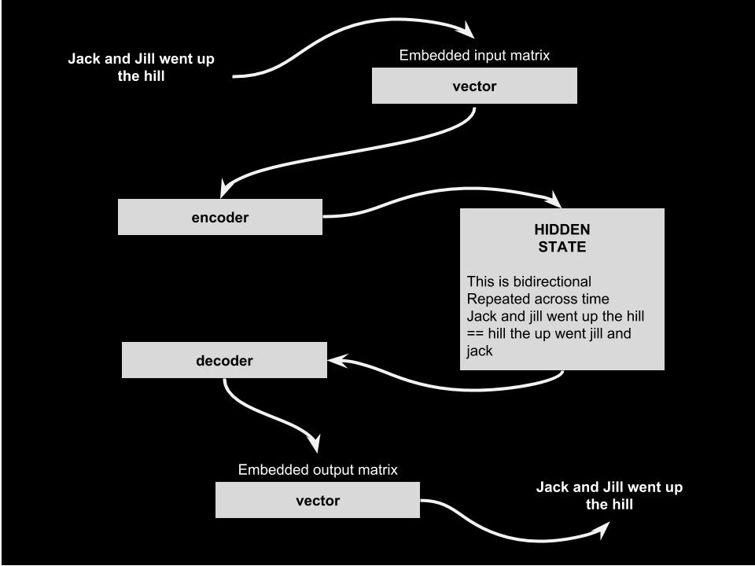
Architecture
It’s all about INPUT SEQUENCE <=> OUTPUT SEQUENCE as memory works :)
FUTURE <=> PAST

Slide 11
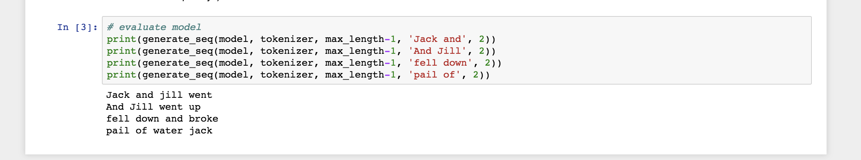
Links:
Today’s Code!! Github: https://github.com/venali/SquenceKeras.git
Contact: venalisono@gmail.com medium @venali

Slide 12
Thank you :)
Questions are welcomed !!

